Slide 1
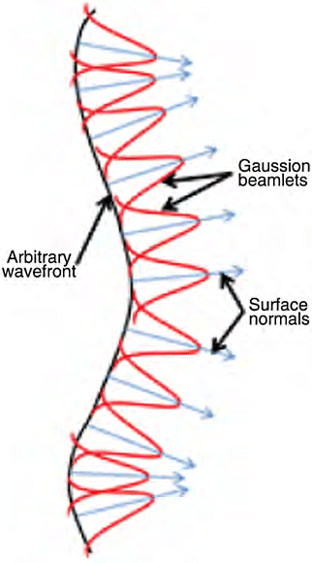
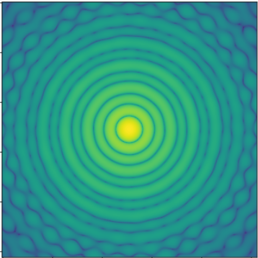
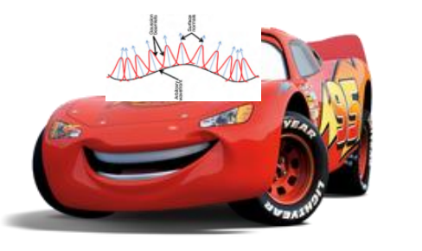
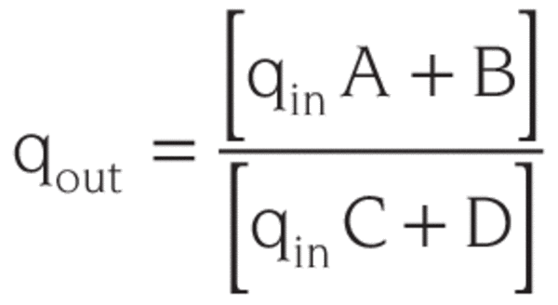
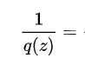
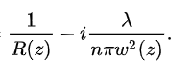
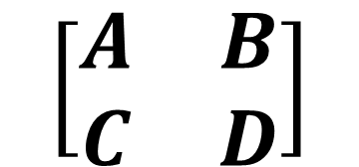
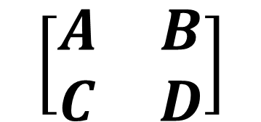
Vignette Rays!
Evaluate!
$$\left[\begin{matrix}A & B \\ C & D\end{matrix}\right]$$
$$\left[\begin{matrix}A & B \\ C & D\end{matrix}\right]$$
Propagate!
Propagate!
Speed… I am Speed

Slide 2
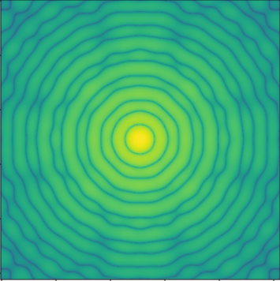
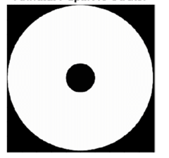
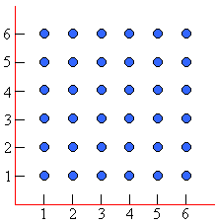
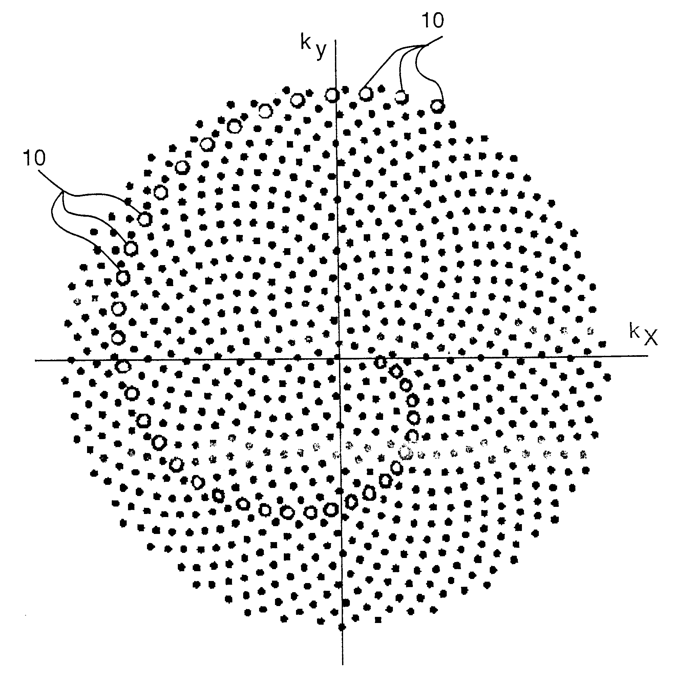
Annular Aperture PSF
Fibbonacci Spiral Sampling
Square Grid Sampling

Slide 3
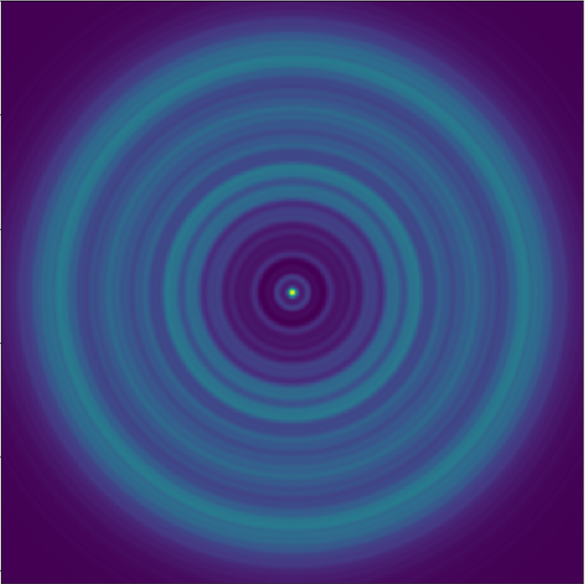
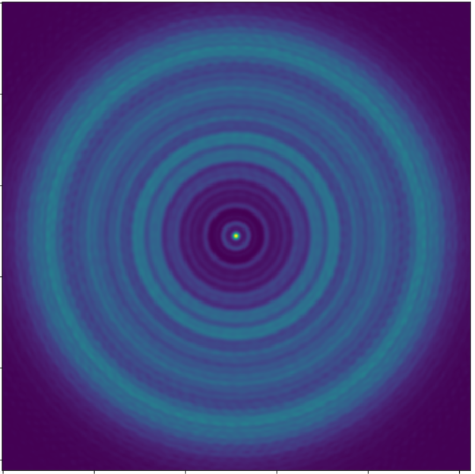
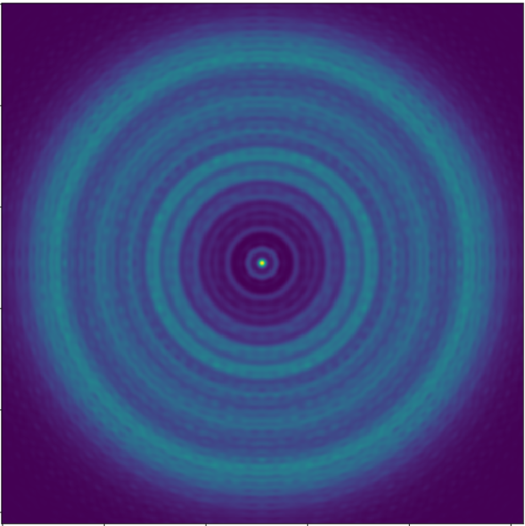
Fresnel
GBD Fibonacci
GBD Even

Slide 4
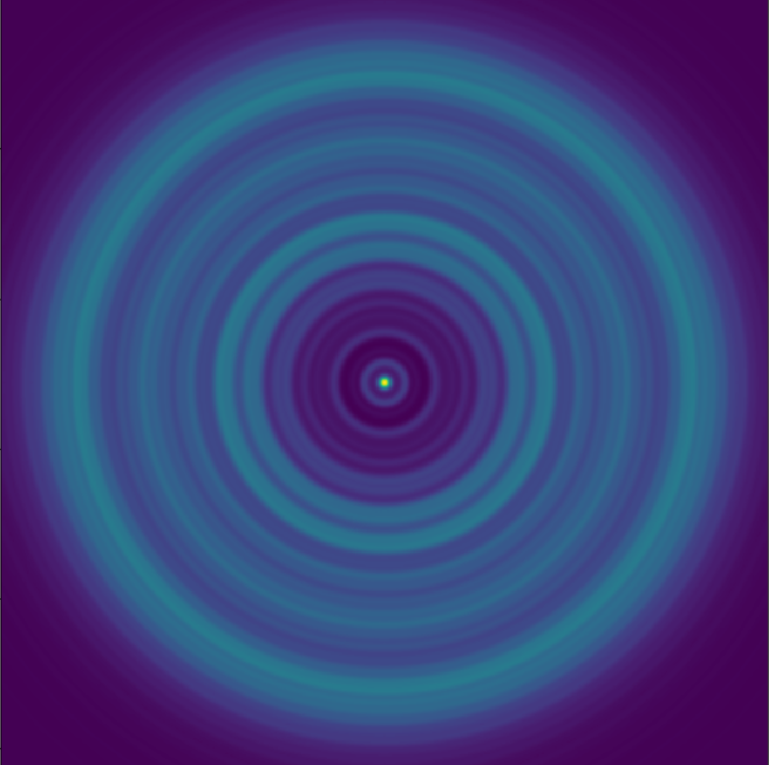
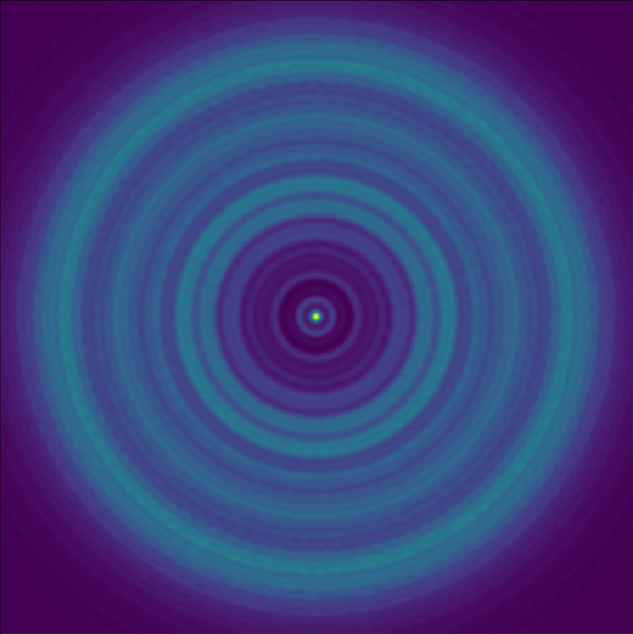
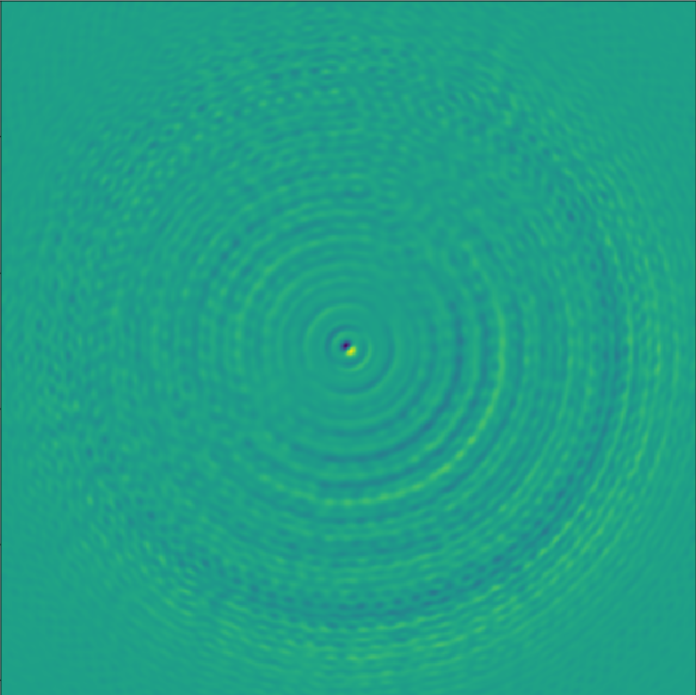

Slide 5
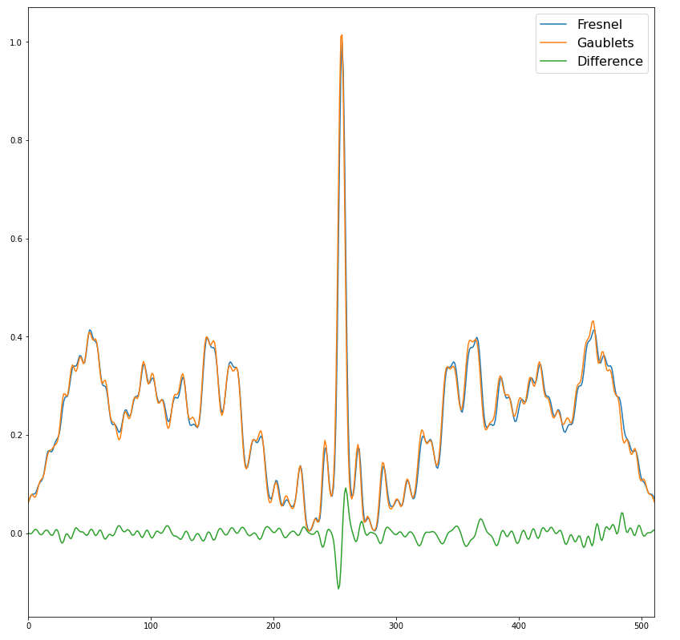
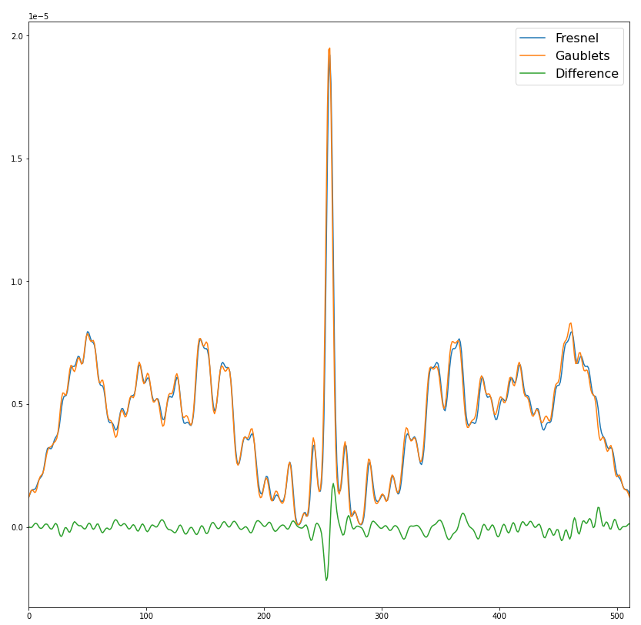

Slide 6
Cameras
LLOWFS
VVC
OAP3
OAP4
LP+QWP
DM
OAP2
OAP1
PBS
M3
FSM
Source

Slide 7
Software | Open Source | Publicly Available | Polarization | Parallel | Near Field | Far Field | Ray Trace | Tilts + Decenters
POPPY
PROPER
HCIPY |  |  | Jones Vector
FALCO |  | Requires MATLAB
CODE V
ZEMAX OpticStudio
FRED
POPPY + GBD |  |  | Polarization Raytrace

Slide 8
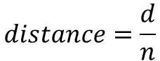
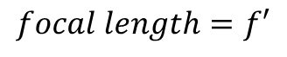
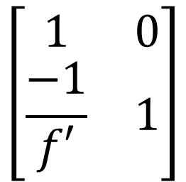
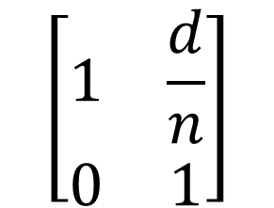
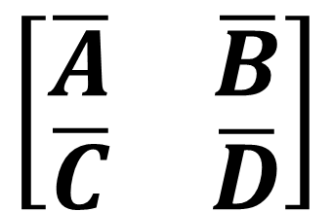
$$focal length=f′$$
$$\left[\begin{matrix}1 & 0 \\ \frac{−1}{f′} & 1\end{matrix}\right]$$
$$\left[\begin{matrix}\overline{A} & \overline{B} \\ \overline{C} & \overline{D}\end{matrix}\right]$$
$$\left[\begin{matrix}1 & \frac{d}{n} \\ 0 & 1\end{matrix}\right]$$
$$distance=\frac{d}{n}$$

Slide 9
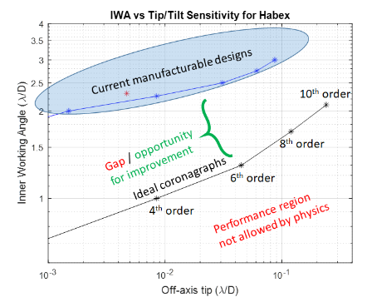
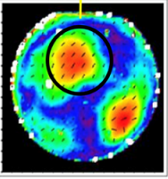

Slide 10
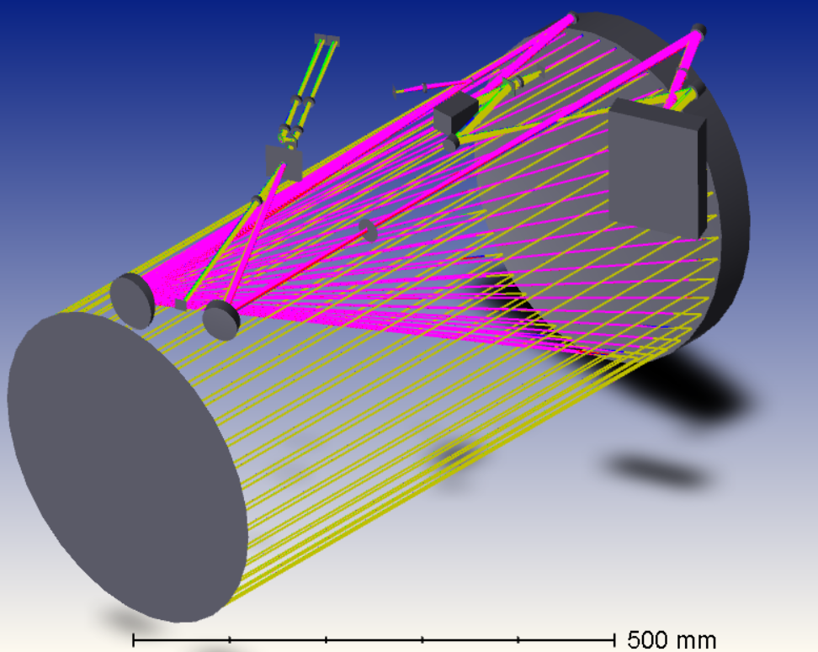
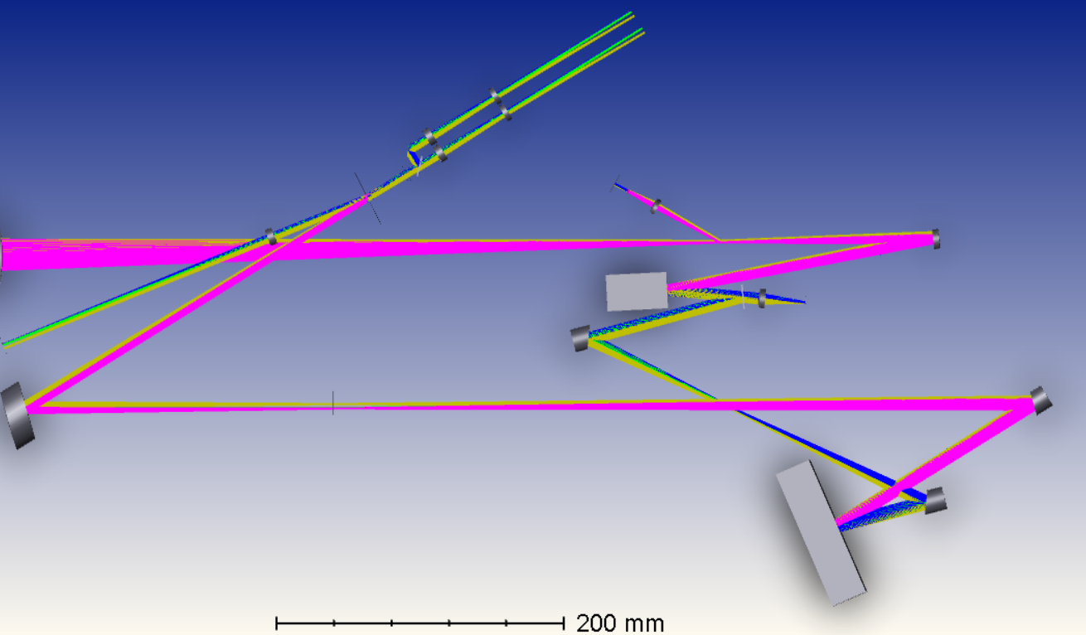
Science Cameras
Lyot Stop
Coarse
Pointing
Camera
Light from
Telescope
OAP
LLOWFS
FSM
Fine
Pointing
Camera
OAP
VVC
OAP
OAP
OAP
DM

Slide 11
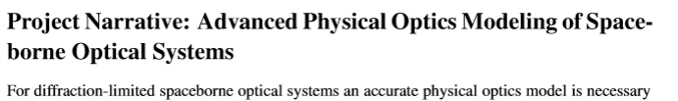

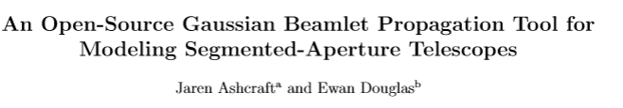

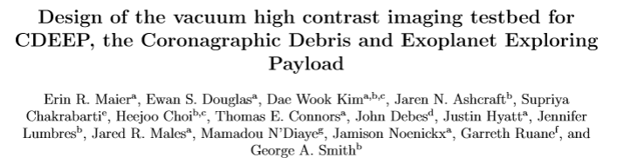

Complete
Progress
Progress

Slide 12
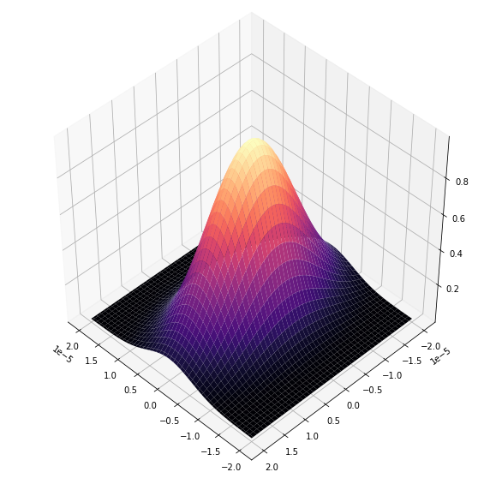
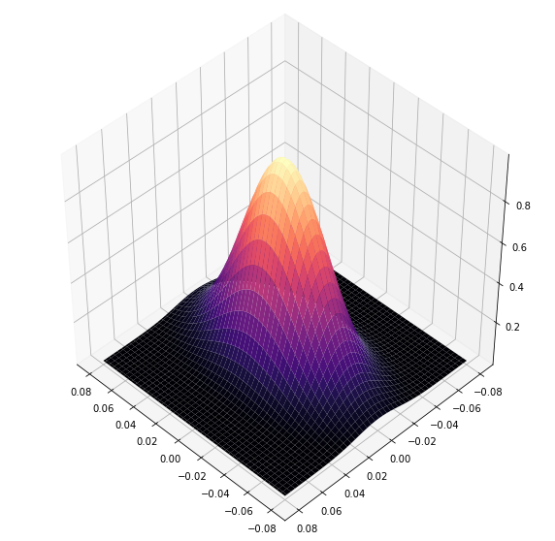
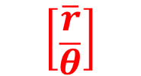
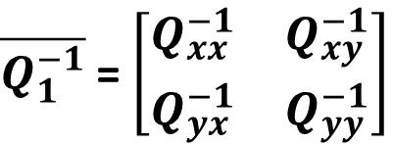
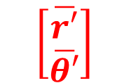
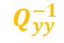
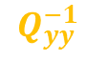
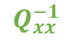
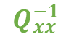
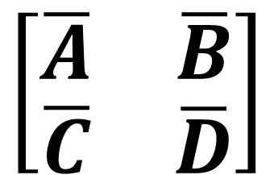
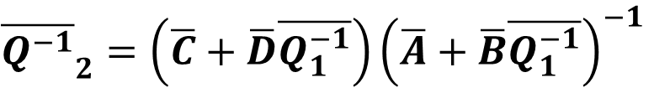
$\overline{Q_{1}^{−1}}$ = $\left[\begin{matrix}Q_{xx}^{−1} & Q_{xy}^{−1} \\ Q_{yx}^{−1} & Q_{yy}^{−1}\end{matrix}\right]$
${\overline{Q^{−1}}}_{2}=\left(\overline{C}+\overline{D}\overline{Q_{1}^{−1}}\right){\left(\overline{A}+\overline{B}\overline{Q_{1}^{−1}}\right)}^{−1}$
$$Q_{yy}^{−1}$$
Optical System
$$Q_{yy}^{−1}$$
$$\left[\begin{matrix}\overline{A} & \overline{B} \\ \overline{C} & \overline{D}\end{matrix}\right]$$
$$Q_{xx}^{−1}$$
$$\left[\begin{matrix}\overline{r} \\ \overline{θ}\end{matrix}\right]$$
$$\left[\begin{matrix}\overline{r′} \\ \overline{θ′}\end{matrix}\right]$$
$$Q_{xx}^{−1}$$

Slide 13
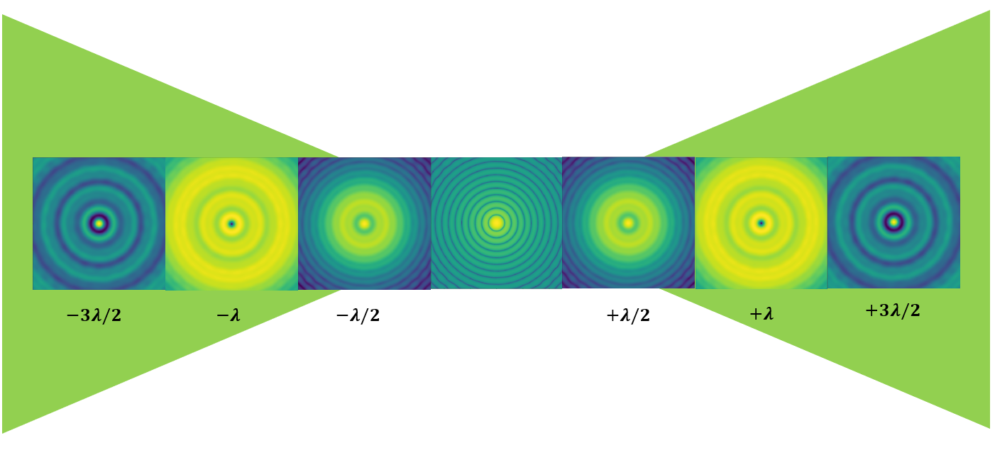

Slide 14
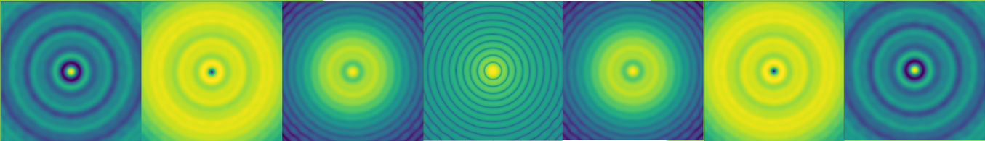
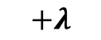
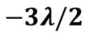
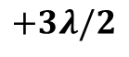
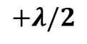
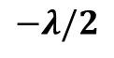


$$−3λ/2$$
$$−λ$$
$$−λ/2$$
$$Focus$$
$$+λ/2$$
$$+λ$$
$$+3λ/2$$

Slide 15

Poppy.Fresnel
Beamlets

Slide 16



Slide 17


Slide 18
N 4f Relays

Slide 19

Science
Cameras
LLOWFS
Beam Splitter
VVC
OAP3
OAP4
LP+QWP
OAP2
Kilo-DM
OAP1
M3
FSM

Slide 20


Jx = 1

Slide 21


Jx = Jy = 1

Slide 22


Jy = 1

Slide 23

Unwrapping – try +45º
Phase = mod(Phase,45)

Slide 24

4
S
5
F

